Slide 1
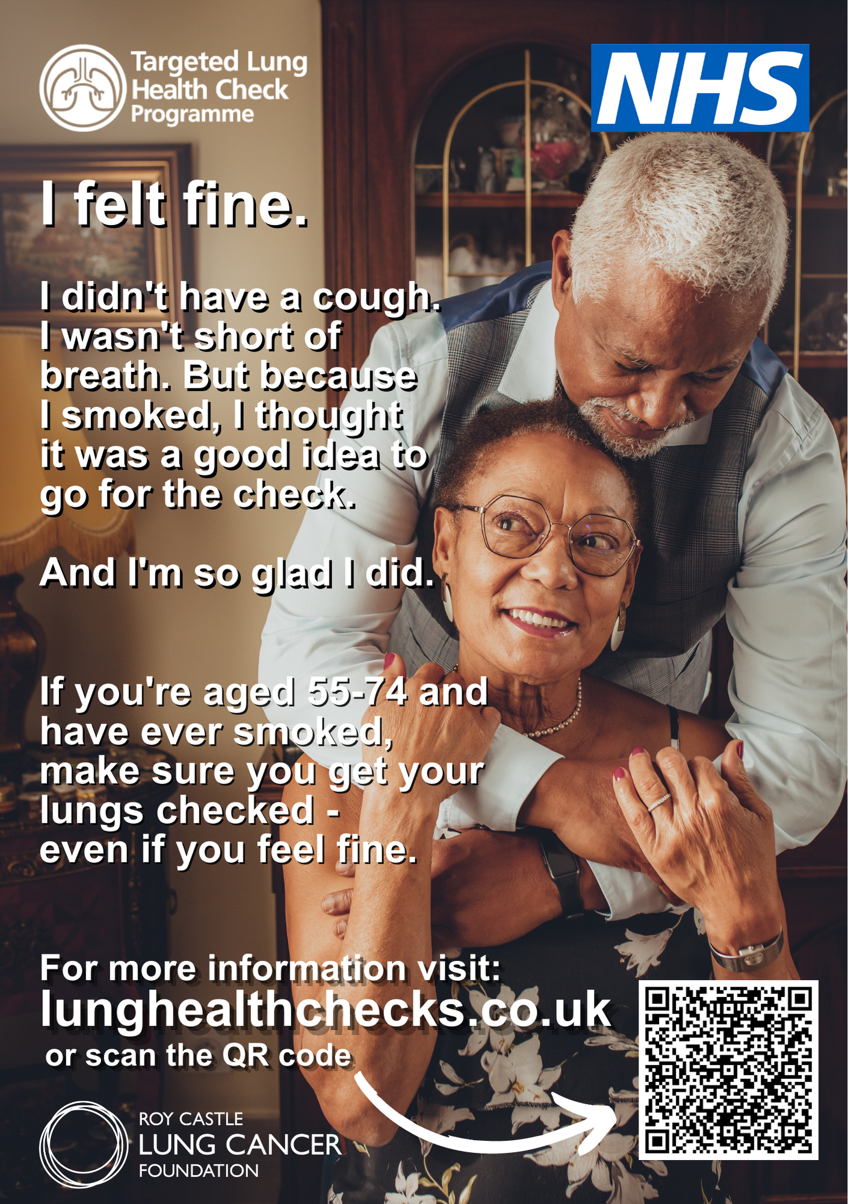
Grenoside Surgery
Practice Newsletter
Welcome to the latest issue of our Practice Newsletter
Useful Numbers
Northern General Hospital (0114) 243 4343
Royal Hallamshire Hospital (0114) 271 1900
Sheffield Children’s Hospital (0114) 271 7000
Weston Park Hospital (0114) 226 5000
Charles Clifford Dental Hosp (0114) 271 7800
Pharmacies
Well Pharmacy (Grenoside) (0114) 245 0021
Allied Pharmacy (Margetson) (0114) 232 1741
Well Pharmacy (Southey) (0114) 232 5462
Asda Pharmacy (Chaucer) (0114) 294 4250
Parson Cross Pharmacy (0114) 240 0390
News!
Alison Leigh
New Role:
Reception Lead
Ellie Pickering
Receptionist
Job Board
Full Time Nurse Vacancy – Closes 22 December Job Advert
The practice will be closed for staff training one afternoon a month from 1.00pm
The Next PLI is:
28.01.2025
Should you need a doctor during this time, please telephone the surgery number and your call will be dealt with by the GP collaborative
If you are unable to attend always cancel your appointment
To cancel or rearrange
call us on 0114 240 3159
24 hours a day
Select option 1 to leave a message Text 07758 721550
Visit the practice in person to rearrange
What would you like to
see in this newsletter,
on our Facebook page or
on our surgery website?
Do you have any ideas?
If so, please speak to Kara Eaves or leave a suggestion at reception.

Slide 2
